Slide 1
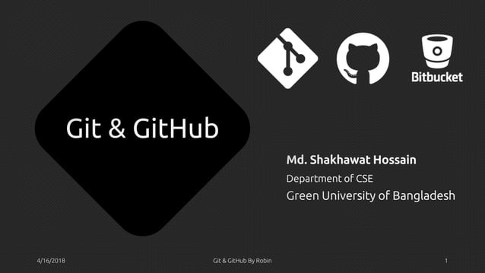

Slide 2

Overview
What is Version Control? What is Git?
How does Git work? What is GitHub?
Install Git
Gitg GltHub9YRobon
'

Slide 3
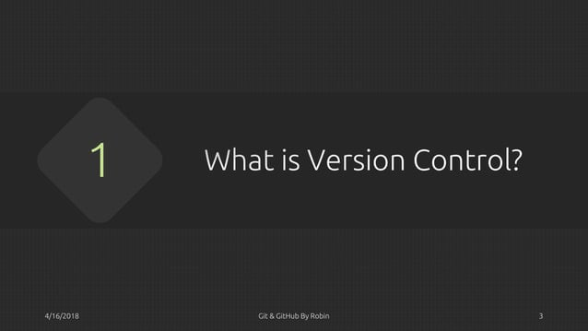

Slide 4

What is Version Control?
A system that keeps records of your changes
Allows for collaborative development
Allows you to know who made what changes and when
Allows you to revert any changes and go back to a previous state
Git&CiltHub eyAob,n
•

Slide 5
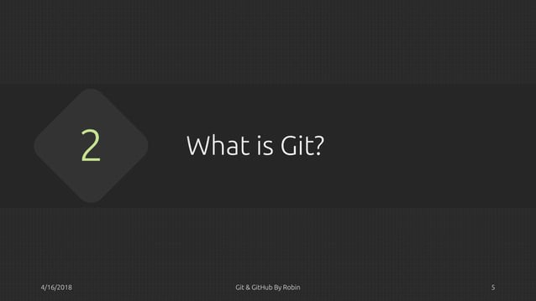

Slide 6

What is Git?
Global Information Tracker
Git is a distributed version control system
Every dev has a working copy of the code and full change history on their local machine _By Linus Torvalds.
Started in 2005
Created by Linus Torvald to aid in Linux
kernel development
git
•
Gitg CiltHub eyAob,n

Slide 7
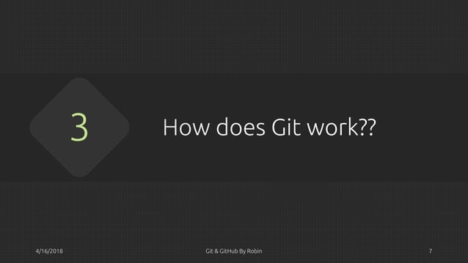

Slide 8

How Does Git Works?
Commit
Repositories
Cloning
Pulling
Pushing
Branches
Merging
•
Gitg CiltHub eyRobin

Slide 9

Commit
Can be a noun or verb
"I commited code"
"I just made a new commit"
Essentially, a project is made up of a bunch of commits
Commits contain three pieces of information:
Information about the changed from previous
A reference to the parent commit
A hash code name: f2d2ec5069fc6776c80b3ad6b7
•
Gitg CiltHub eyRobin

Slide 10

Repositories
The short form of repo is knows as
repository in Git
It's a collection of all the files and the history of those files
Basically it's a place where all your hard work is stored
10

Slide 11

Repositories--> Cloning
The act of copying a repository from a remote server is called cloning
Cloning From a remote server allows teams to work together
"

Slide 12

Repositories--> Pulling
The process of downloading commits that don't exist on your machine from a remote repository is called pulling changes
12

Slide 13

Repositories--> Pushing
The process of adding your local changes to the remote repository is called pushing changes
I)

Slide 14

Branches
All commits in git live on some branch
But there can be many, many branches
The main branch in a project is called the master branch
A bunch of commits linked together that live on some branch, contained in a repository
..
Git &CiltHub eyAob,n

Slide 15

Merging
Once you're done with your feature, you merge it back into master
Gitg CiltHub eyRobin
"

Slide 16
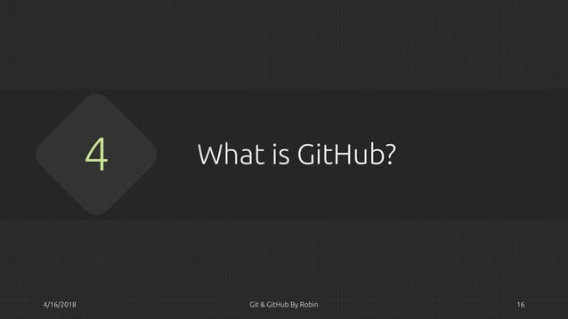

Slide 17

GitHub
GitHub is a web-based hosting service for version control using git
www.github.com
Largest web-based git repository hosting service
Aka, hosts 'remote repositories·
Allows for code collaboration with anyone online Founded in 2008
Free for students as part of the Student Developer Pack.
11

Slide 18

BitBucket
www.bitbucket.org
Largest web-based git repository hosting service
Allows for code collaboration with anyone online
Adds extra functionality on top of git Founded in 2010
Free for up to S users
Gitg CiltHub eyRobin
18

Slide 19
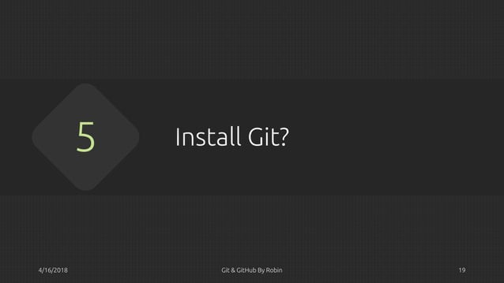

Slide 20

Install Git
Linux (Debian)-
Command: sudo apt-get installgit
Linux (Fedora) -
Command: sudo yum installgit
Mac­
http://git-scm.com/download/mac
Windows­
http://git-scm.com/download/win
20

Slide 21


